Slide 1

Intrusion Detection System for DDoS Attacks
Submitted By:
Name: Yash Agrawal
University Roll: 2024201
GUIDE: MR. SIDDHANT THAPLIYAL
(ASSISTANT PROFESSOR)
TEAM ID: G37

Slide 2
Introduction and Problem Statement
INTRODUCTION
Overview of the importance of online security in the digital age.
Explanation of DDoS attacks and their impact on online services.
Aim of the project to develop an IDS for detection and mitigation DDoS attack.

Slide 3
Introduction and Problem Statement
PROBLEM STATEMENT
Challenges in detecting and mitigating DDoS attack on cloud-based servers.
Need for advanced detection capabilities and effective mitigating strategies.

Slide 4
Literature Survey
Review of existing IDS Techniques:
Intrusion Detection Systems (IDS) are critical for identifying and mitigating cyber threats. Various techniques have been developed over the years, including signature-based, anomaly-based, and hybrid approaches.
Signature-based IDS relies on predefined patterns of known threats, while anomaly-based IDS detects deviations from normal behaviour. Hybrid IDS combines both methods to enhance detection accuracy.
Gaps in Existing Methods:
Despite advancements, traditional IDS techniques often struggle with high false positive rates and the evolving nature of DDoS attacks. There is a need for more robust and adaptive models that can accurately distinguish between normal and malicious traffic.

Slide 5
Literature Survey
DDoS Attack Patterns:
Distributed Denial of Service (DDoS) attacks overwhelm a target server with a flood of internet traffic, rendering it inaccessible to legitimate users. These attacks can be volumetric, protocol-based, or application layer attacks
Previous studies have explored various machine learning and deep learning approaches to detect DDoS attacks. Techniques such as Support Vector Machines (SVM), Neural Networks, and Ensemble Methods have shown promise in improving detection rates.

Slide 6
Objectives
Primary Goals:
Develop an Intrusion Detection System (IDS) specifically designed to detect and mitigate DDoS attacks in real-time.
Leverage advanced machine learning techniques to enhance detection accuracy and response efficiency.
Specific Aims:
Analyse and Detect DDoS Attacks: Implement a system capable of analysing network traffic in real-time to identify potential DDoS attacks.
Deploy AI-Enabled Model: Utilize machine learning algorithms to improve the system's ability to distinguish between normal and malicious traffic.
Minimize False Positives and Negatives: Ensure the IDS can accurately identify threats while minimizing false alarms.

Slide 7
Architectural Design
System Architecture
The Intrusion Detection System (IDS) is designed with a multi-layered architecture to enhance detection accuracy and response efficiency.
Components:
Data Collection Module: Gathers network traffic data in real-time.
Pre-processing Module: Cleans and prepares the data for analysis.
Detection Module: Utilizes machine learning algorithms to identify potential DDoS attacks.
Mitigation Module: Implements strategies to counteract detected attacks and maintain server availability.
Flowchart:
A flowchart illustrating the data flow between these components, from data collection to mitigation.

Slide 8

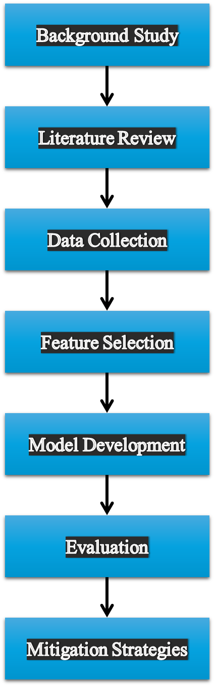
Flowchart
Flow chart of the methodology

Slide 9
Implementation of Objectives
Objective 1: Analyse and Detect DDoS Attacks
Developed a machine learning model to analyse network traffic and detect anomalies indicative of DDoS attack.
Objective 2: Deploy AI-Enabled Model
Trained a machine learning model using datasets of normal and malicious traffic.
Developed the model within the detection module to enhance the system’s ability to detect DDoS attack.
Objective 3: Minimize False Positives and Negatives
Fine-tuned the model parameters to balance sensitivity and specificity.
Conducted extensive testing to ensure the model accurately distinguishes between normal and malicious traffic.

Slide 10
Data Sets and Data Pre-processing
Data Sets:
Utilized public available datasets such as the Ddos SDN dataset, which includes labelled instances of normal and attack traffic from kaggle.
Collected additional data from simulated network environments to supplements to supplement the training data.
The data sets size is around 104345 rows × 23 columns.
Data Pre-processing
Removed irrelevant features and handled missing values.
Normalized the data to ensure consistent input for the machine learning model.
Split the data into training and testing sets to evaluate model performance.

Slide 11
Discussion of Results
Analysis:
The model achieved an accuracy of 100% in detecting DDoS attacks on the test dataset.
False positive and false negative rates were minimized through parameter tuning and extensive testing.
Comparison with Expected Outcomes:
The results met the project objectives, demonstrating the effectiveness of the IDS in real-time detection and mitigation of DDoS attacks.

Slide 12
Confusion Matrix
Predicted
Predicted Not
Actual
19108
4
TP
FN
Actual Not
1
12191
FP
TN

